Slide 1
SPS Horizon Scanning Service – All you need to know!
Helen Davis and Joanne McEntee
Horizon Scanning Strategic Lead and Horizon Scanning Operations Lead

Slide 2
What will be covered
History of the SPS horizon scanning service (HSS)
Relationship with other UK horizon scanning organisations
SPS horizon scanning publications and reports
Future plans

Slide 3
HISTORY of The sps hSs
1997
2007
2012
2017
1992
2022
2002
External developments
1999
NICE set up
1998
NHSC set up, incorporated into NIHR in 2006
1996
NPC set up
Internal developments
Pre 1993
UKDIPG stage 3 assessments
1998
UKMI & NPC collaboration - detailed monographs < 2 years to launch
1997
Regional level top line horizon scanning

Slide 4
HISTORY of The sps hSs
1997
2002
2007
2012
2017
1992
2022
External developments
1999
NICE set up
2011
NPC incorporated into NICE
2009
UKPharmaScan set up
1998
NHSC set up, incorporated into NIHR in 2006
2002 AWMSG set up
2005
SMC set up
2011
NHS England set up
1996
NPC set up
Internal developments
Pre 1993
UKDIPG stage 3 assessments
1998
UKMI & NPC collaboration - detailed monographs < 2 years to launch
2003 Prescribing Outlook (part A, B & C)
2010
New medicines monthly newsletter
1997
Regional level top line horizon scanning
2003
UKMI HS database NDO
2003
Monthly list of evaluations

Slide 5
HISTORY of The sps hSs
1997
2002
2007
2012
2017
1992
2022
External developments
1999
NICE set up
2011
NPC incorporated into NICE
2009
UKPharmaScan set up
1998
NHSC set up, incorporated into NIHR in 2006
2019
ATMP PWG
2002 AWMSG set up
2011
NHS England set up
2020 collaboration between SPS and NHSE
2005
SMC set up
2022
MHRA
AAC
1996
NPC set up
Internal developments
Pre 1993
UKDIPG stage 3 assessments
1998
UKMI & NPC collaboration - detailed monographs < 2 years to launch
2003 Prescribing Outlook (part A, B & C)
2010
New medicines monthly newsletter
2016
SPS website developed (New Medicines pages)
2017 Combined NM & ND
2021
NM & CC only
1997
Regional level top line horizon scanning
2003
UKMI HS database NDO
2003
Monthly list of evaluations

Slide 6




UK horizon scanning organisations

Slide 7
horizon scanning organisations - ENGLAND
NIHRIO stakeholders
Research community
NICE
AAC
NHS England
SPS stakeholders
NHS providers and commissioners
Area prescribing committees
NHS England
NHS BSA

Slide 8
What is unique to SPS?
Using a combination of data, knowledge and expertise we:
Estimate earliest date of UK availability to NHS patients
Anticipate place in therapy
Anticipate commissioning route
Anticipate tariff positioning
Assess impact for NHS in terms of financial and operational implications

Slide 9
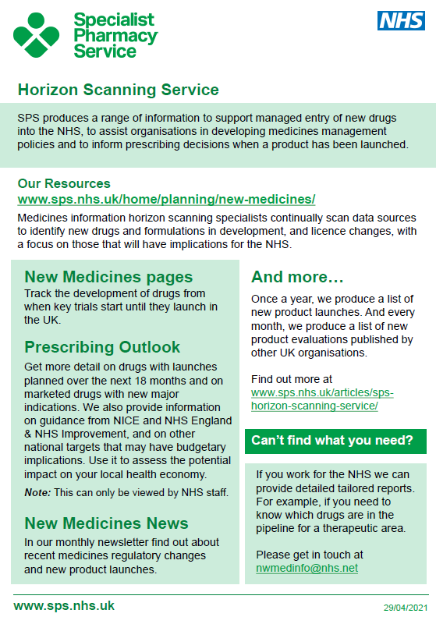
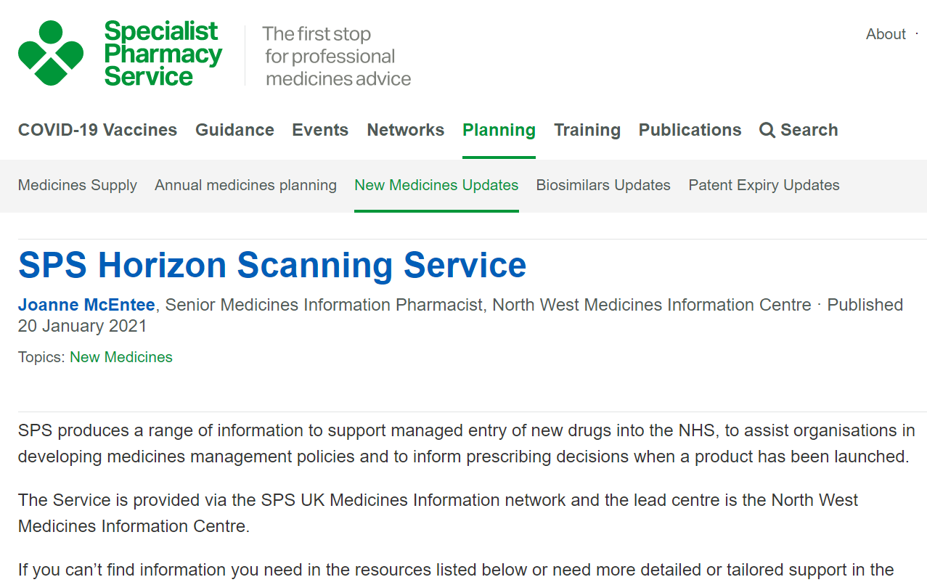
FINDING out what is on offer
https://www.sps.nhs.uk/articles/sps-horizon-scanning-service/
Notes:
SPS produces a range of information to support managed entry of new drugs into the NHS, to assist organisations in developing medicines management policies and to inform prescribing decisions when a product has been launched.
SPS horizon scanning service The SPS horizon scanning service provides information on medicines in development tailored to user need. This is provided as spreadsheet reports, done at the user’s request, at a time that suits them, and includes information current at the time the report is created.

Slide 10
Horizon scanning timeline
Phase 3
Filing
Launch
Bespoke reports
SPS New medicines pages
ATMPs
Biosimilars
New Product Launches
Patent expiries
Prescribing Outlook
New Medicines News
New Product Evaluations

Slide 11
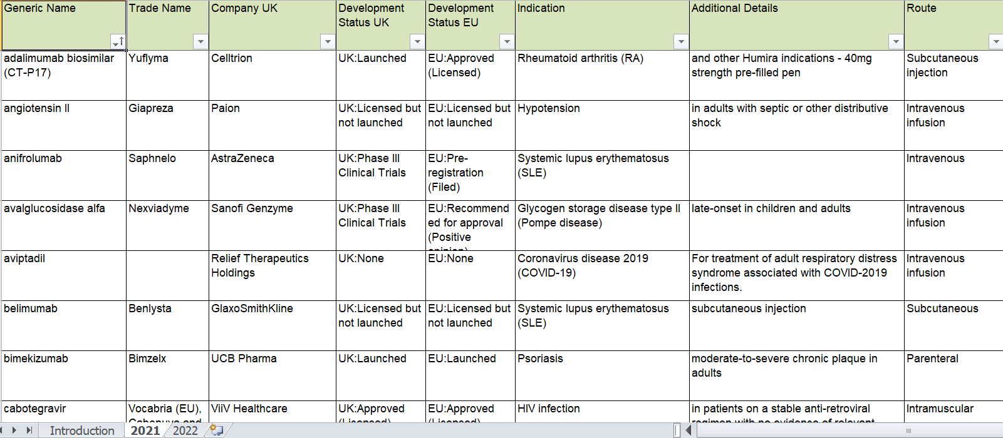
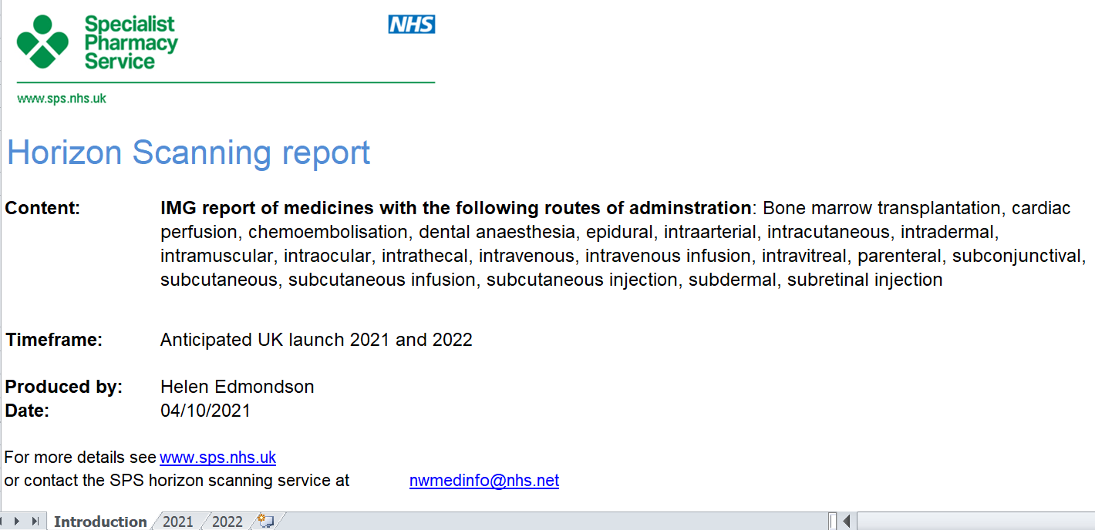
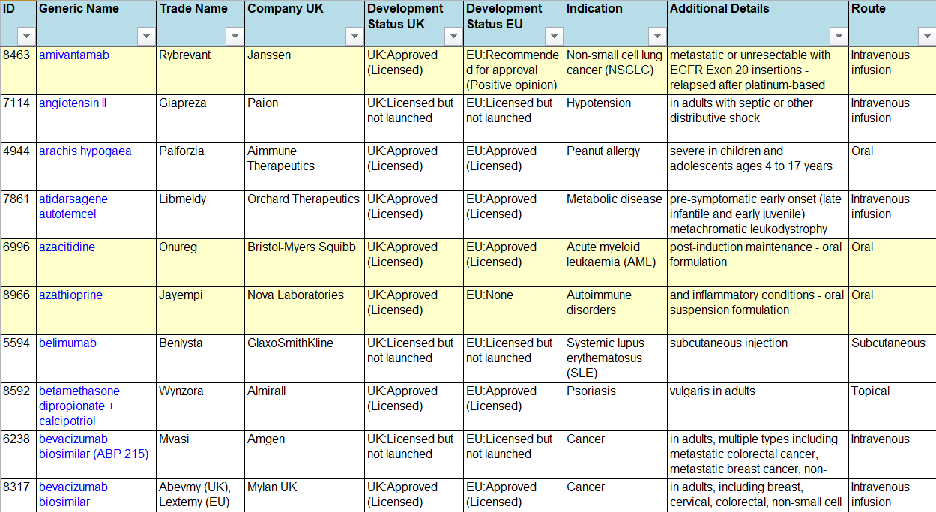
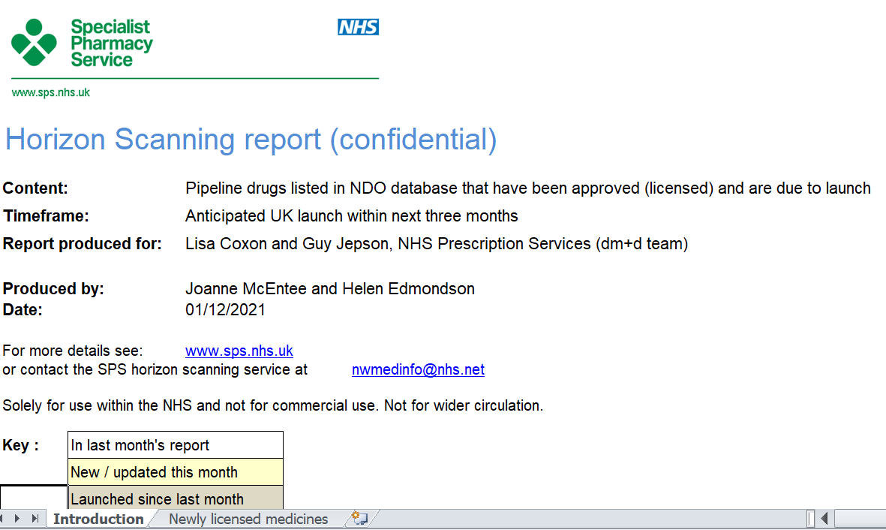
Bespoke reports
AWMSG
IMG
Pan UK PWG ATMPs
dm+d
HCDSG
Contact nwmedinfo@nhs.net

Slide 12
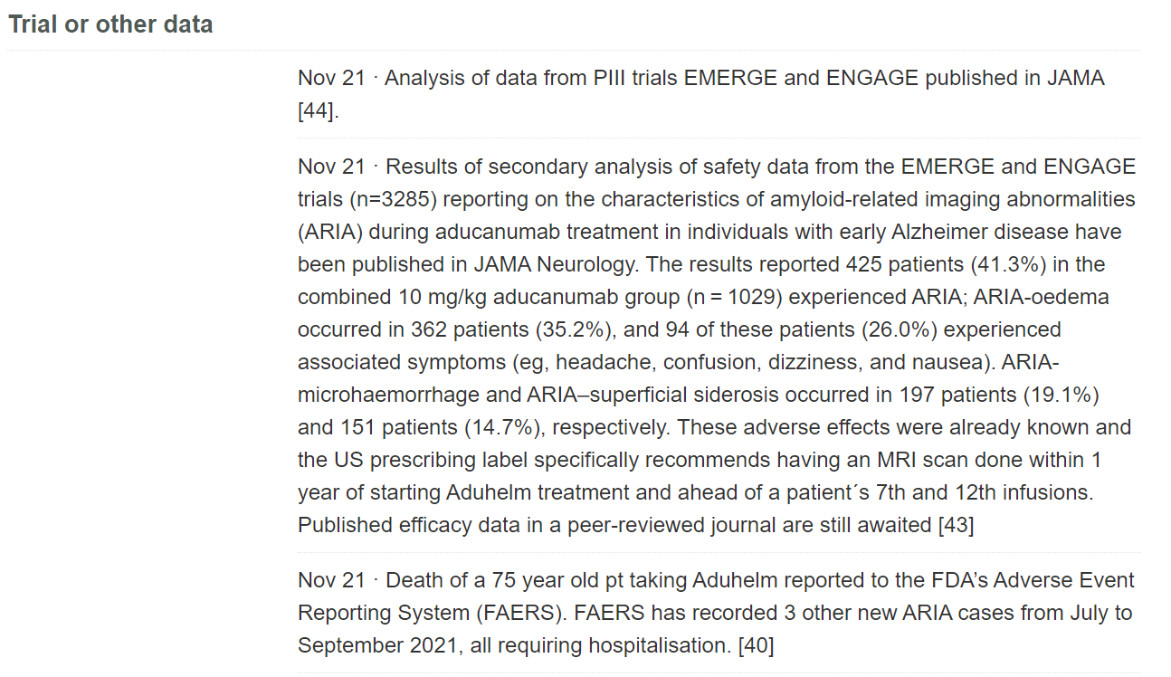
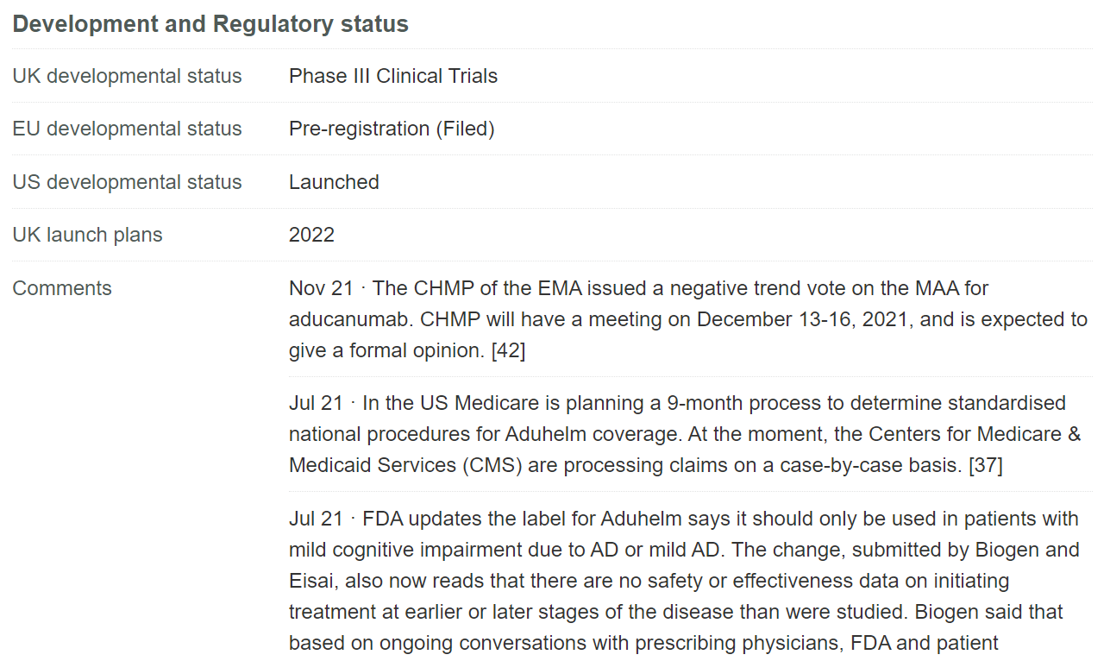
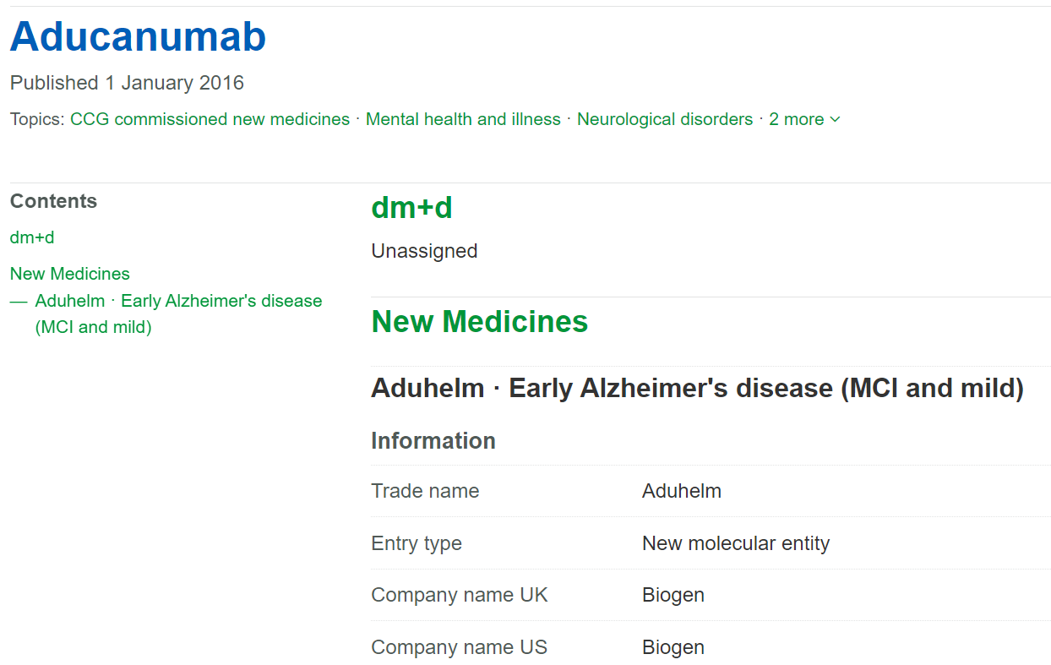
SPS New medicines pages
Brand name
Company name
Pharmacology
Epidemiology
Indication
Method of administration
Development and regulatory status
Trial data including UK sites
Links to evidence-based evaluations
Link to NICE technology appraisal
NHS staff who are registered can log in for additional information
Notes:
New Medicines section of the SPS website There are over 1,000 new medicines pages on the SPS website. These pages include monographs on drugs in development and contain brief details such as name, company, proposed indication, stage of development, pharmacology and epidemiology. More detail (including trial data) is added once the company applies for a licence and you can track the development of the drug through to launch as it happens.

Slide 13
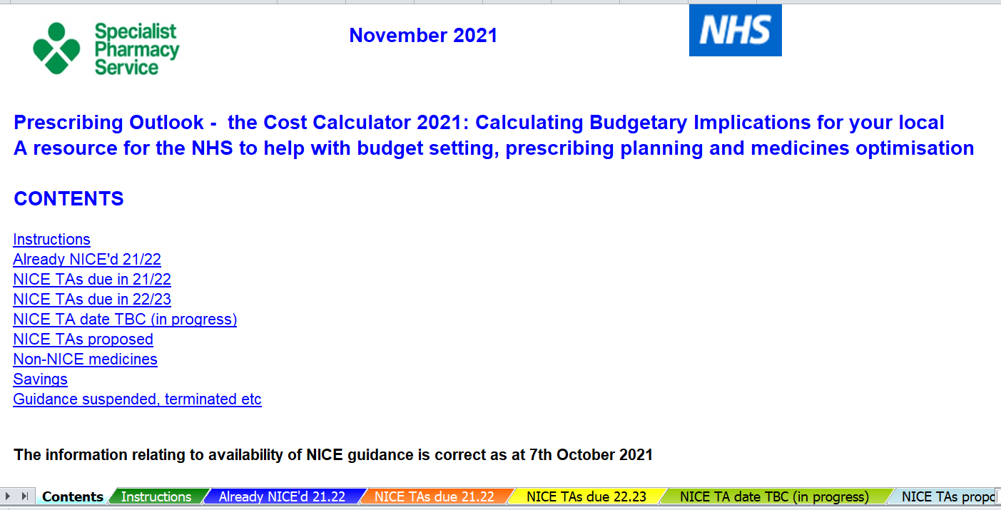
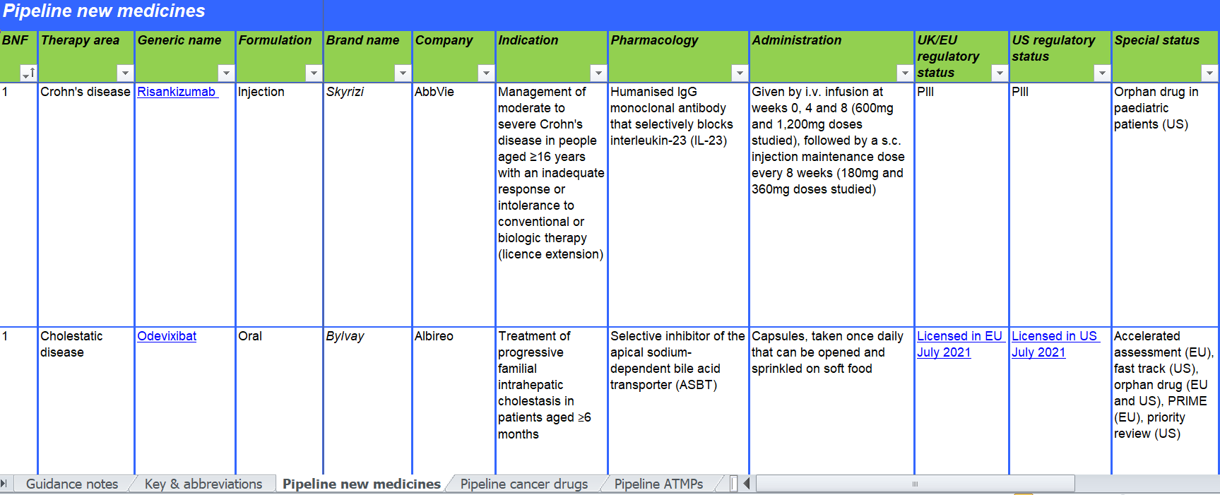
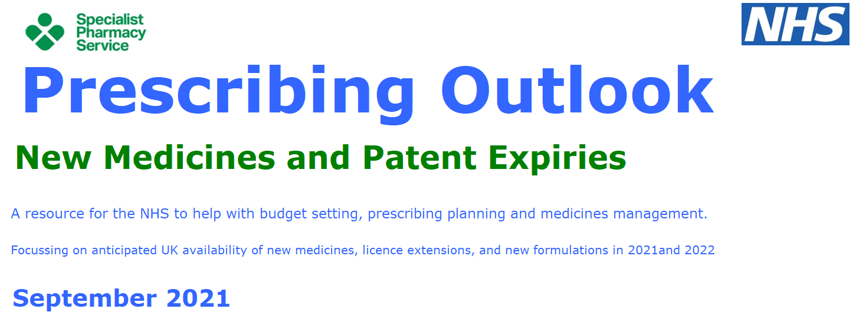
PREscribing outlook
Aims to help NHS organisations plan, implement and budget for new medicines or licence extensions.
Provides support to commissioners and providers by highlighting new medicines that may have financial and operational implications in the next 18 months.
Published each autumn in line with annual budget planning timeframes.
Notes:
Prescribing Outlook The annual Prescribing Outlook Series is intended to assist NHS budget holders and those involved in prescribing planning assess potential impact of new drugs and national guidance on the local health economy.

Slide 14
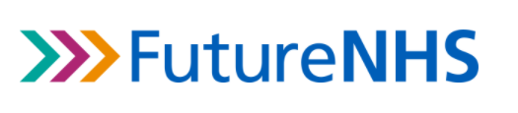
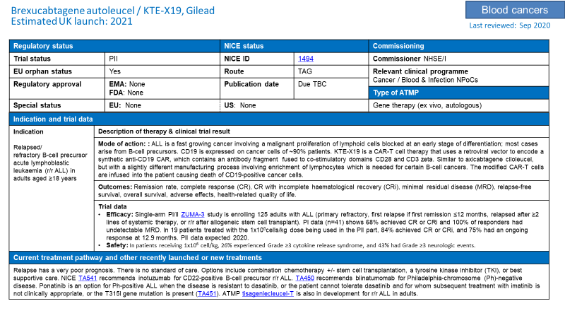
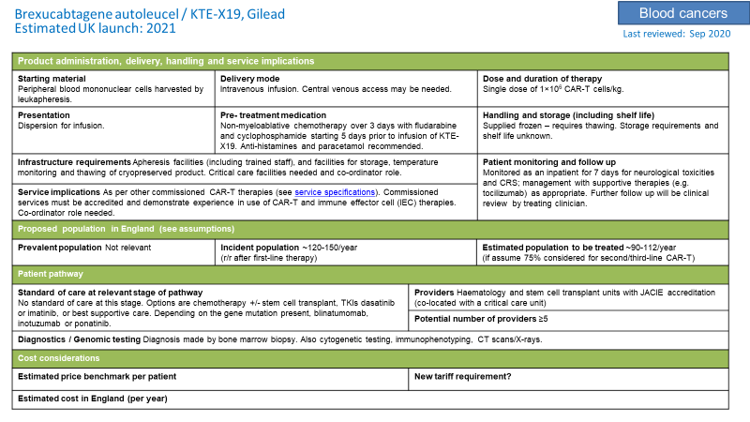

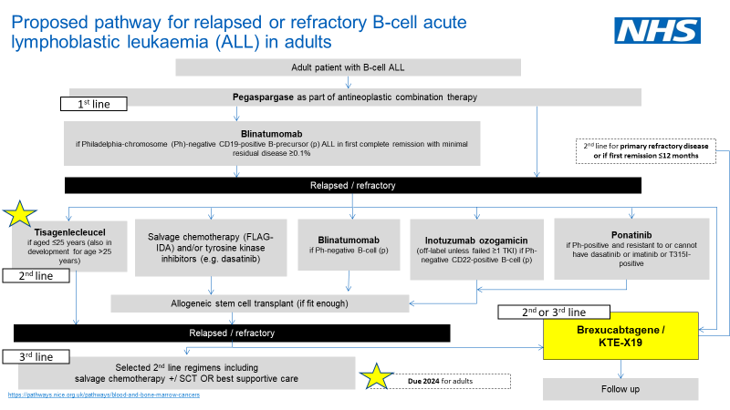
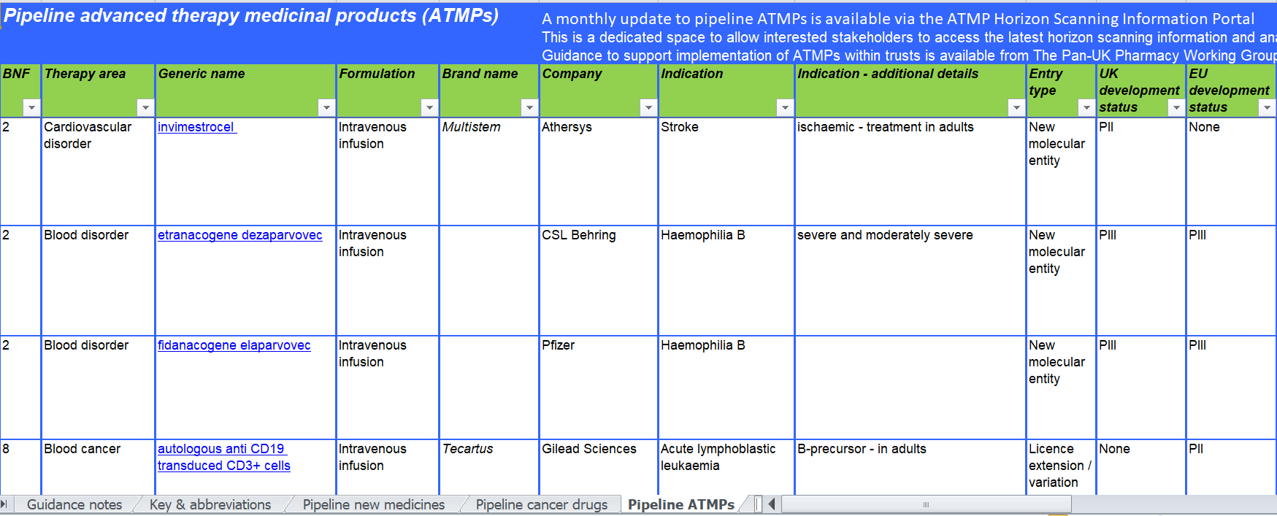
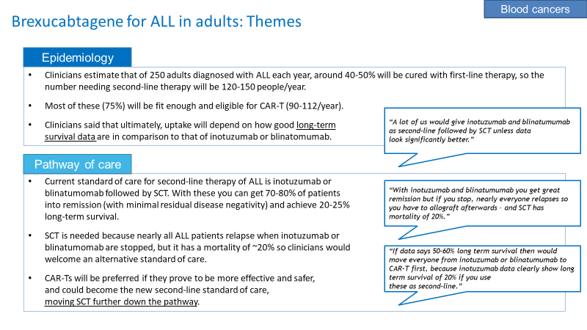
Advanced therapies
Collaboration with NHSE/I
Prescribing Outlook signposts
NHS Futures ATMP report highlights implementation challenges
https://future.nhs.uk/ATMP_HSIP/grouphome

Slide 15
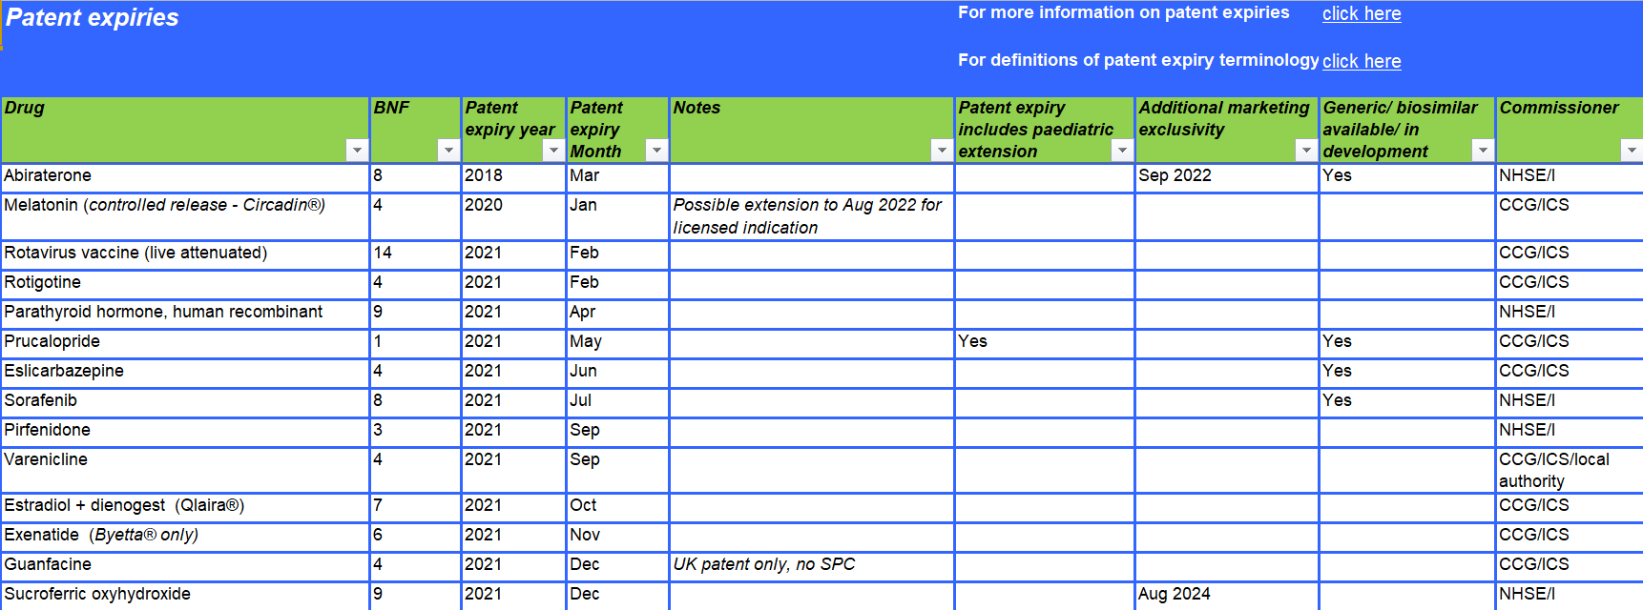
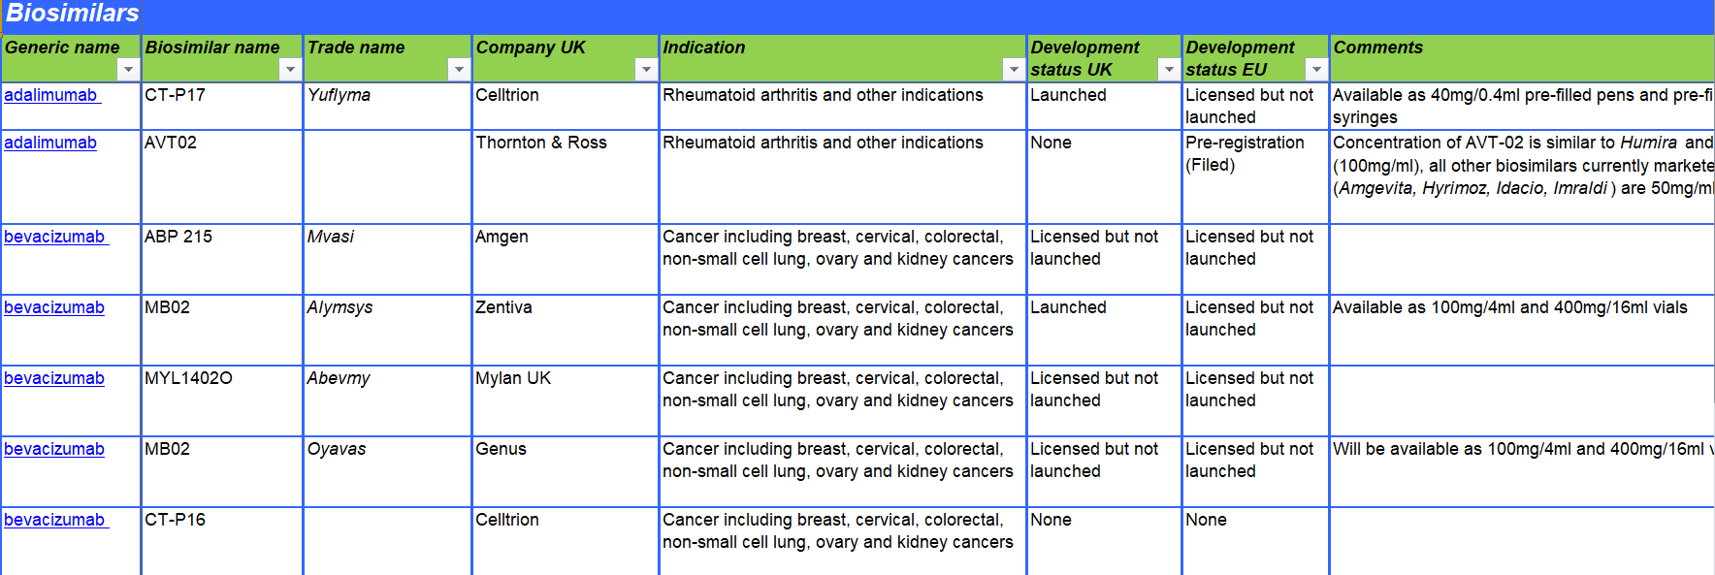
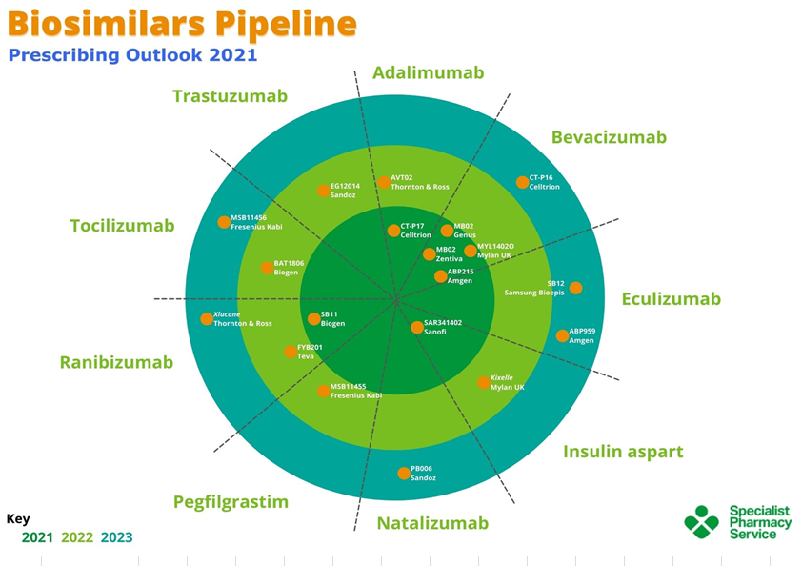
Biosimilars and patent expiries
Forward look 5 years
Generics and biosimilars
Opportunities to make savings

Slide 16
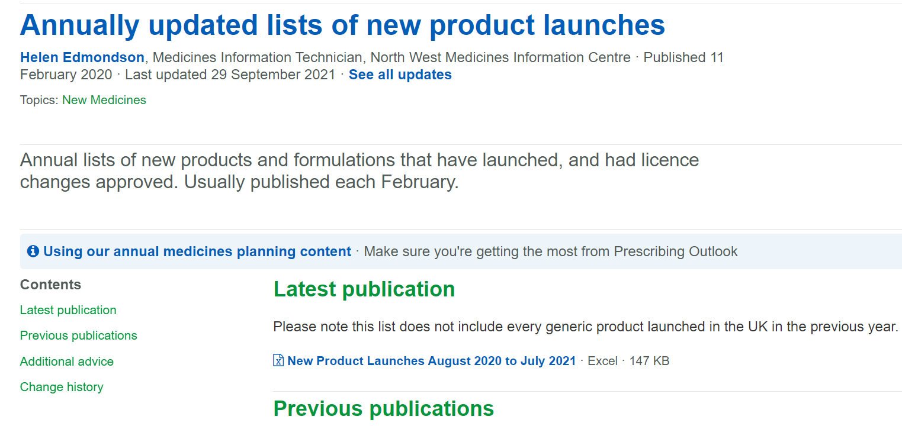
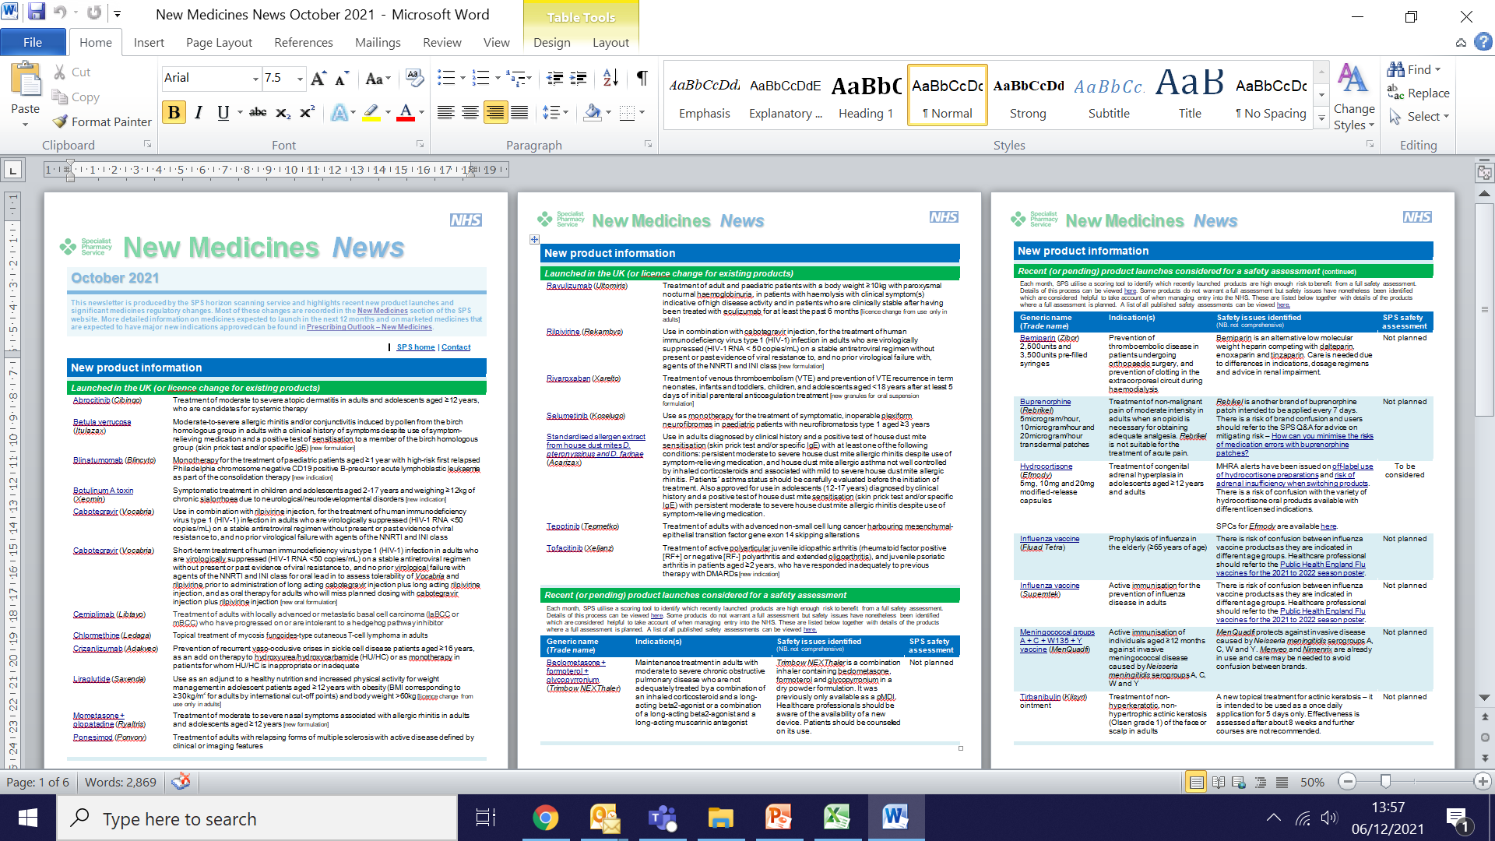
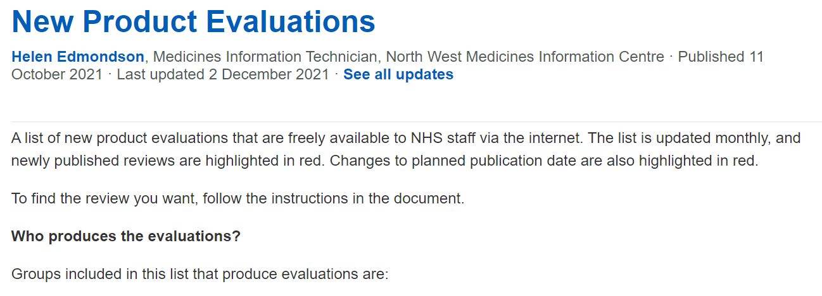
Other publications
Notes:
New Medicines News New Medicines Newsletter (now New Medicines News) is intended to help NHS staff (and others working for organisations such as NICE and NHS England) who need to introduce new medicines into use. It alerts them to the medicines that are close to launch so they can plan their work in reviewing new medicines. It also lets them know when these medicines have launched and those that are no longer going to arrive.
New Product Evaluations SPS produces a list of UK new product evaluations (medicines and devices) in production, or published in the previous three years. It is published monthly (usually in the first week of each month). It’s intended to save people time hunting for medicines reviews.
New Product Launches Once a year, SPS produces a list of new products (medicines and devices) and formulations launched, and licence changes approved, in the previous year.

Slide 17
Using our outputs
Prescribing Outlook
New Medicines News
SPS New Medicines
New Product Launches
New Product Evaluations
Chief / hospital / medicines management pharmacists
Prescribing committee members
Community / hospital / medicines information pharmacists
Medicines management pharmacists
RMOC members
Procurement pharmacists
Medicines management pharmacists
Community / hospital / medicines information pharmacists

Slide 18
Beyond 2022
Block vs Cost & volume
ICSs & ICBs
Medicines systemisation

Slide 19
Beyond 2022
Volunteers
Contact nwmedinfo@nhs.net or indicate in chat

